Slide 1
MongoDB Aggregation

Slide 2
Aggregation Introduction
Aggregations operations process data records and return computed results
Aggregation operations group values from multiple documents together, and can perform a variety of operations on the grouped data
MongoDB provides three ways to perform aggregation:
the aggregation pipeline,
the map-reduce function, and
single purpose aggregation methods
For aggregation in mongodb use aggregate() method
Syntax:
>db.COLLECTION_NAME.aggregate(AGGREGATE_OPERATION)

Slide 3
Aggregation Pipeline
MongoDB’s aggregation framework is modeled on the concept of data processing pipelines
Documents enter a multi-stage pipeline that transforms the documents into an aggregated result
Other pipeline operations provide tools for grouping and sorting documents by specific field or fields
In addition, pipeline stages can use operators for tasks such as calculating the average or concatenating a string

Slide 4
Different Expression Used by Aggregate Function
Expression | Description | Example
$sum | Sums up the defined value from all documents in the collection. | db.mycol.aggregate([{$group : {_id : "$by_user", num_tutorial : {$sum : "$likes"}}}])
$avg | Calculates the average of all given values from all documents in the collection. | db.mycol.aggregate([{$group : {_id : "$by_user", num_tutorial : {$avg : "$likes"}}}])
$min | Gets the minimum of the corresponding values from all documents in the collection. | db.mycol.aggregate([{$group : {_id : "$by_user", num_tutorial : {$min : "$likes"}}}])
$max | Gets the maximum of the corresponding values from all documents in the collection. | db.mycol.aggregate([{$group : {_id : "$by_user", num_tutorial : {$max : "$likes"}}}])

Slide 5
Different Expression Used by Aggregate Function
Expression | Description | Example
$push | Inserts the value to an array in the resulting document. | db.mycol.aggregate([{$group : {_id : "$by_user", url : {$push: "$url"}}}])
$addToSet | Inserts the value to an array in the resulting document but does not create duplicates. | db.mycol.aggregate([{$group : {_id : "$by_user", url : {$addToSet : "$url"}}}])
$first | Gets the first document from the source documents according to the grouping. Typically this makes only sense together with some previously applied “$sort”-stage. | db.mycol.aggregate([{$group : {_id : "$by_user", first_url : {$first : "$url"}}}])
$last | Gets the last document from the source documents according to the grouping. Typically this makes only sense together with some previously applied “$sort”-stage. | db.mycol.aggregate([{$group : {_id : "$by_user", last_url : {$last : "$url"}}}])

Slide 6
Pipeline Concept
There is a set of possible stages and each of those is taken as a set of documents as an input and produces a resulting set of documents

Slide 7
Aggregation Example
First Stage: The $match stage filters the documents by the status field and passes to the next stage those documents that have status equal to "A".
Second Stage: The $group stage groups the documents by the cust_id field to calculate the sum of the amount for each unique cust_id.
db.orders.aggregate([
{ $match: { status: "A" } },
{ $group: { _id: "$cust_id", total: { $sum: "$amount" } } }
])

Slide 8
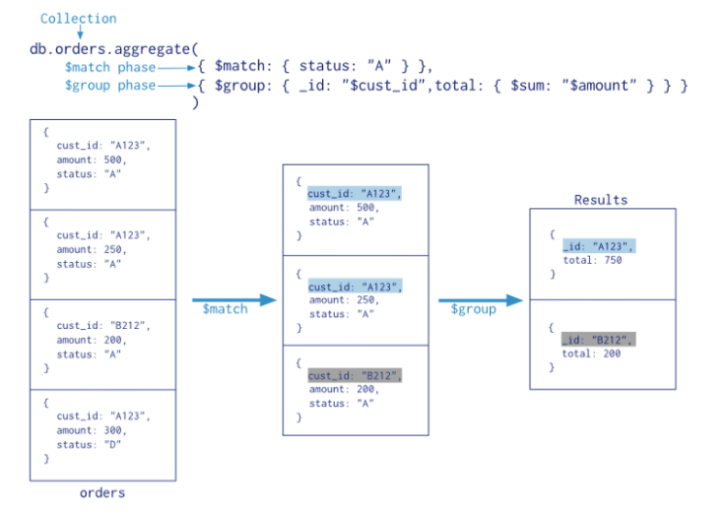
Aggregation Example

Slide 9
Possible stages in aggregation
$project − Used to select some specific fields from a collection
$match − This is a filtering operation and thus this can reduce the amount of documents that are given as input to the next stage
$group − This does the actual aggregation
$sort − Sorts the documents
$skip − With this, it is possible to skip forward in the list of documents for a given amount of documents
$limit − This limits the amount of documents to look at, by the given number starting from the current positions
$unwind − This is used to unwind document that are using arrays. When using an array, the data is kind of pre-joined and this operation will be undone with this to have individual documents again. Thus with this stage we will increase the amount of documents for the next stage.

Slide 10
Example Collection
db.student.insert({Rollno:1,name:”Navin “,subject:”DMSA”,marks:78}); db.student.insert({Rollno:2,name:”anusha”,subject:”OSD”,marks:75}); db.student.insert({Rollno:3,name:”ravi”,subject:”TOC”,marks:69}); db.student.insert({Rollno:4,name:”veena”,subject:”TOC”,marks:70}); db.student.insert({Rollno:5,name: “Pravini”,subject: “OSD”,marks:80}); db.student.insert({Rollno:6,name: “Reena”,subject: “DMSA”,marks:50}); db.student.insert({Rollno:7,name: “Geeta”,subject: “CN”,marks:90}); db.student.insert({Rollno:8,name: “Akash”,subject: “CN”,marks:85});

Slide 11
Project
Put
0: when _id field is not required in the result
1: when field is required in the result
db.student.aggregate ([{$project : {_id : 0, name : 1}}]);
db.student.aggregate ([{$project : {name:1 marks : 1}}]);

Slide 12
MIN()
db.student.aggregate ([{$group : {_id : "$subject", marks : {$min : "$marks"}}}]);
SQL Equivalent Query
Select subject, min(marks) from student group by subject

Slide 13
MAX()
db.student.aggregate ([{$group : {_id : "$subject", marks : {$max : "$marks"}}}]);
SQL Equivalent Query
Select subject, max(marks) from student group by subject

Slide 14
AVG()
db.student.aggregate ([{$group : {_id : "$subject", marks : {$avg : "$marks"}}}]);
SQL Equivalent Query
Select subject, avg(marks) from student group by subject

Slide 15
FIRST()
db.student.aggregate ([{$group : {_id : "$subject", marks : {$first : "$marks"}}}]);

Slide 16
LAST()
db.student.aggregate ([{$group : {_id : "$subject", marks : {$last : "$marks"}}}]);

Slide 17
SUM()-Example 1
db.student.aggregate ([{$group : {_id : "$subject", marks : {$sum : "$marks"}}}]);
SQL Equivalent Query
Select subject, sum(marks) from student group by subject

Slide 18
SUM()-Example 2
db.student.aggregate ([{$group : {_id : "$subject", Count: {$sum : 1}}}]);
SQL Equivalent Query
Select subject, count(*) from student group by subject

Slide 19
$match
db.student.aggregate ([{ $match: {subject:”CN"}}])
db.student.aggregate ([{ $match: {subject:“CN"}}, {$group:{_id:null,count:{$sum:1}}}]);

Slide 20
SUM()-Example 3
db.student.aggregate ([{ $match: {subject:"OSD"}}, {$group:{_id:null,count:{$sum:1}}}]);
SQL Equivalent Query
Select subject, count(*) from student group by subject having subject=“OSD”

Slide 21
Limit() & Skip()
db.student.aggregate ([{ $match: {subject:"OSD"}}, {$limit:1}]);
db.student.aggregate ([{ $match: {subject:"OSD"}}, {$skip:1}]);

Slide 22
Sort()
Sorts all input documents and returns them to the pipeline in sorted order
{ $sort: { <field1>: <sort order>, <field2>: <sort order> ... } }
If sorting on multiple fields, sort order is evaluated from left to right. For example, in the form above, documents are first sorted by <field1>. Then documents with the same <field1> values are further sorted by <field2>
db.student.aggregate ({$sort:{marks:-1}});
db.student.aggregate ({$sort:{_id:1, marks:-1}});

Slide 23
Sort()
db.student.aggregate ([{ $match: {subject:"OSD"}}, {$sort:{marks:-1}}]);
db.student.aggregate ([{ $match: {subject:"OSD"}}, {$sort:{marks:1}}]);

Slide 24
Push()
The $push operator appends a specified value to an array
{ $push: { <field1>: <value1>, ... } }
db.students.insert( { _id: 1, scores: [ 44, 78, 38, 80 ] } )
db.students.update( { _id: 1 }, { $push: { scores: 89 } })

Slide 25
Push()
Append a Value to Arrays in Multiple Documents
db.students.insertMany( [
{ _id: 2, scores: [ 45, 78, 38, 80, 89 ] } ,
{ _id: 3, scores: [ 46, 78, 38, 80, 89 ] },
{ _id: 4, scores: [ 47, 78, 38, 80, 89 ] }
] )
db.students.updateMany(
{ },
{ $push: { scores: 95 } }
)

Slide 26
Unwind()
If following document is their in collection(Array)
db.student.insert({rollno:9,name:"Anavi",marks:[80,30,50]});
db.student.aggregate([{$unwind:"$marks"}])
Using Unwind the above document will be unwinded into 3 different document

Slide 27
Index
Helpful in efficient query processing
In the absence of indexes, MongoDB must scan every document in the collection and retrieve only those documents that match the query
The key determines the field on the basis of which you want to create an index and 1 (or -1) determines the order in which these indexes will be arranged(ascending or descending).

Slide 28
Index
db.COLLECTION_NAME.createIndex({KEY:1})
key is the name of the field on which you want to create index and 1 is for ascending order. To create index in descending order you need to use -1
db.COLLECTION_NAME.dropIndex({KEY:1})
db.COLLECTION_NAME.getIndexes()

